Slide 1


16th October 2026
Dear Parents & Carers,
We have had a lovely autumnal week in school with lots of seasonal learning going on. Chestnut class gave our prospective parent tour an excellent demonstration of how they had been learning about both seed dispersal, and forces, at forest school, through sycamore key helicopters. The parents were very impressed!
So far this term, I have showed round over twenty new perspective families, with two further open afternoon events booked for after half term. It is great to see that positive news about our school is spreading far and wide! The children are a key part of our open afternoon events, and they always make me so proud with the way that they welcome and present themselves to our visitors. Their comments about why they like Woolhampton are really genuine and far better than any ‘sales pitch’ that I could come up with.
This week our Year 6 leadership team were finalised, with children selected for various leadership roles across the school. These roles include: Sports House Captains, Playground leaders, School Council Leaders and Collective Worship leaders. We look for to them starting these roles after half term and playing an important part in running our school.
Safeguarding news – we are aware that one or two children have been discussing ‘Squid Games’ at school. Even if children are not allowed to watch the disturbing 15+ rated programme, they can access clips of the show via various online platforms. With half term and Halloween nearly upon us, we strongly encourage all parents to review their online safety protocols on devices that their children have access to. Internet Matters has lots of really useful information for parents on how to keep children safe online, including this guide: https://www.internetmatters.org/parental-controls. A thought-provoking comment came up on a course I attended recently: ‘Today, children are often over-protected in the real world, but frequently under-protected online.’ As always, if you have any concerns, please do not hesitate to contact us.
To finish on a positive note, I would like to say a big thank you to FoWS for the pumpkin decorating today!
We look forward to welcoming you to the Parent-Teacher meetings next week, and don’t forget we finish the term next week on Wednesday at 3:15pm.
I wish you all a very happy half term when it arrives!
Mrs Rebecca Cox
“Coming together, learning to be the best we can be.”

Slide 2
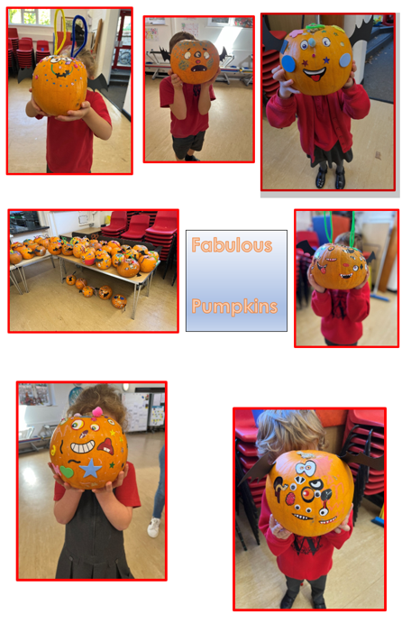

Slide 3
What’s on week commencing 19th October:
 | Monday | Tuesday | Wednesday | Thursday | Friday
Whole School |  | Golden Mile
YR R |  |  | Forest School
Y1 & Y2 |  |  | Year 1 and 2 Forest School
Y3 & Y4 |  | PE
Y5 & Y6
Clubs | Football Club Y1-6 | Dance Club | KS2 Hockey Club Yrs 3-6
Before/After School & Team Events
Additional Information:
Coming Up…. | Wednesday 21st October - Parent-Teacher Meetings Wednesday 21st October – End of Term. 3:15pm Finish. Half Term - Thursday 22nd - Sunday 30th October Wednesday 11th November - Remembrance Service 10:50am Friday 20th November - Sharing Assembly - 2:30pm Thursday 3rd and Friday 4th - Beech and Sycamore Class Nativity. Thursday 10th December - Whole School Trip to the pantomime. Friday 11th December - After School Disco Thursday 17th December - Christingle Service - St Peters Church at 1:15pm Thursday 17th December - End of Term 2:00pm

Slide 4
Important - Safety at Drop-Off and Collection Time
To keep everyone safe please following these simple steps at drop off and collection time (and please ensure that anyone else dropping off or collecting your child is aware of this too):
Parking - please do not park on the double yellow lines, the yellow zigzag lines, on the bend or outside Elstree School entrance. When parking please take care not to mount the pavement, especially when pedestrians are walking along the path.
Turning – please do not turn around in the school gates, entrances to the staff carparks, or further down the road at the grass triangle point as this is a private road. If you do need to turn, please find a safe alternative place and remain courteous to other road users and residents - do not use the private road triangle.
Your cooperation in keeping our community safe is gratefully appreciated.

Slide 5


Slide 6

Our FOWS AGM is coming up on 2nd November at 6.45pm, and we’d really love to see as many parents as possible there.
We want the committee to reflect the whole school community, so if you’d like to get more involved, have an idea to share, or would simply like to find out more about what we do, please come along and let us know.
The PTA plays an important role in raising money for the school. Over the last couple of years, we’ve been able to provide vital funds towards the refurbishment of the playground and purchase a new school minibus, things that directly benefit our children.
So please come along, find out what’s happening, have your say and cast your vote. We’d really love to see you there!
FoWS News

Slide 7

Firework tickets are now on sale!
And the good news… ticket prices are frozen at last year’s prices! Scan the QR code or use the link below.
https://www.pta-events.co.uk/friendsofwoolhamptonschool/?event=event&eventId=122871

Slide 8

Opportunity to work in school
If you know of anyone looking for this particular role please let them know.

Slide 9
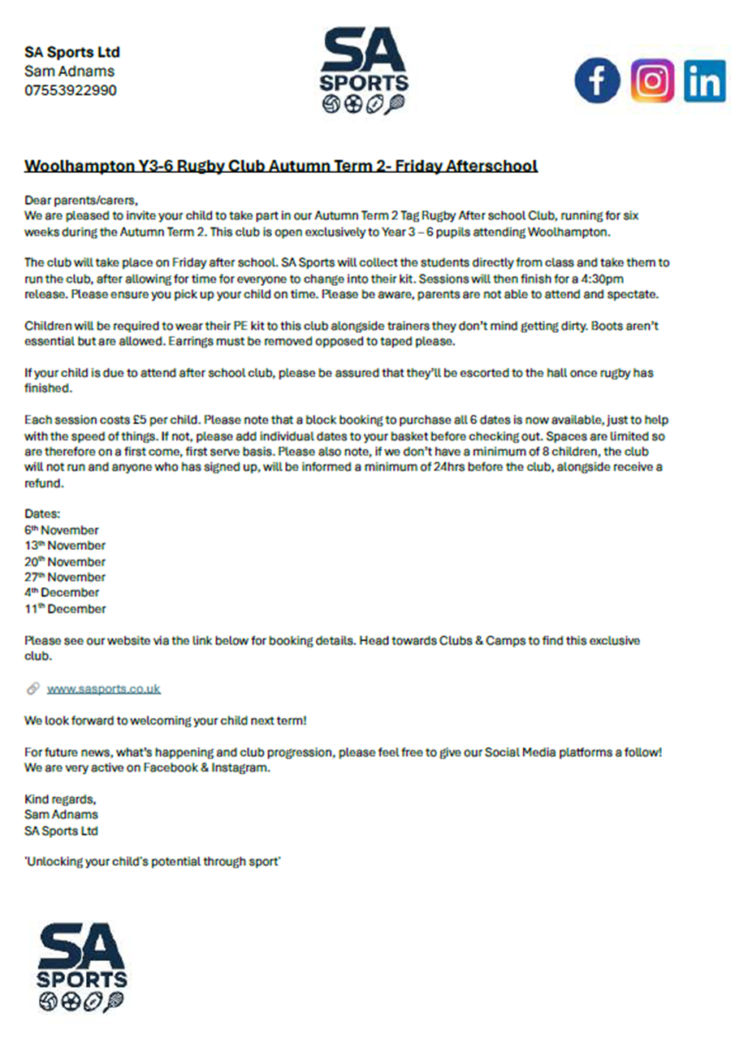

Slide 10


